Slide 1
Mobile Security
15-421/08-731 and 08-761/46-861 -- Fall 2013 – Lecture 8
Information Security & Privacy
Norman M. Sadeh
School of Computer Science
Carnegie Mellon University

Slide 2
Practical Info
Mini semester:
Grading HW assignment and midterm exams
Hoping to get HW#2 out tonight – otherwise Saturday
Full semester: Project teams to come and see me every other week
Also, go and talk the TA’s: they are very knowledgeable and eager to also help project teams

Slide 3
Outline
Mobile: General Trends – incl. BYOD
Understanding the unique challenges associated with mobility
Taxonomy of Vulnerabilities
Best practices
Mobile Device Management
Employee is a big part of the solution
Concluding Remarks
Student Presentation: Jailbroken iPhone Security

Slide 4
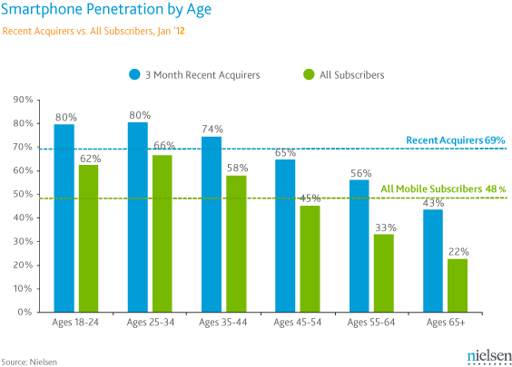
Smart Phones (US): Guess Who’s Driving Adoption
As of Sept 2013: smartphones account for 64% of cellphones in use and 80% of cellphones sold (source: Nielsen 9/17/2013)
http://www.nielsen.com/us/en/newswire/2013/smartphone-switch--three-fourths-of-recent-acquirers-chose-smart.html

Slide 5
Mobile Threats by Categories
Physical Threats
Lost or stolen device
Network Threats
Network exploits (e.g. WiFi, Bluetooth, SMS)
WiFi Sniffing
Web-based Threats
Phishing scams
Drive-by downloads
Browser exploits
App-Based Threats
Malware
Spyware
Privacy Threats
Vulnerable Apps

Slide 6
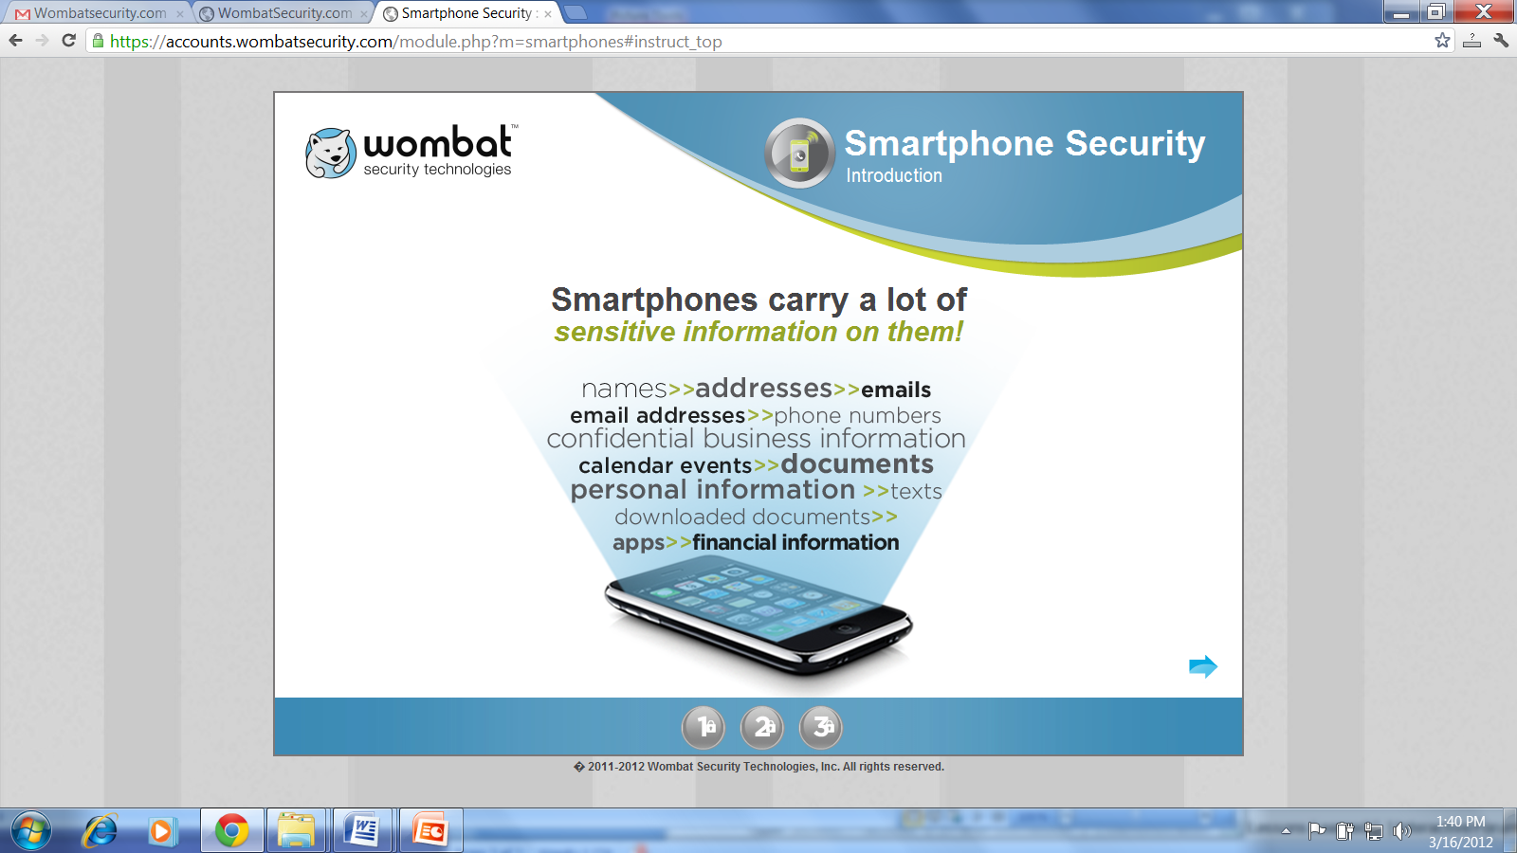
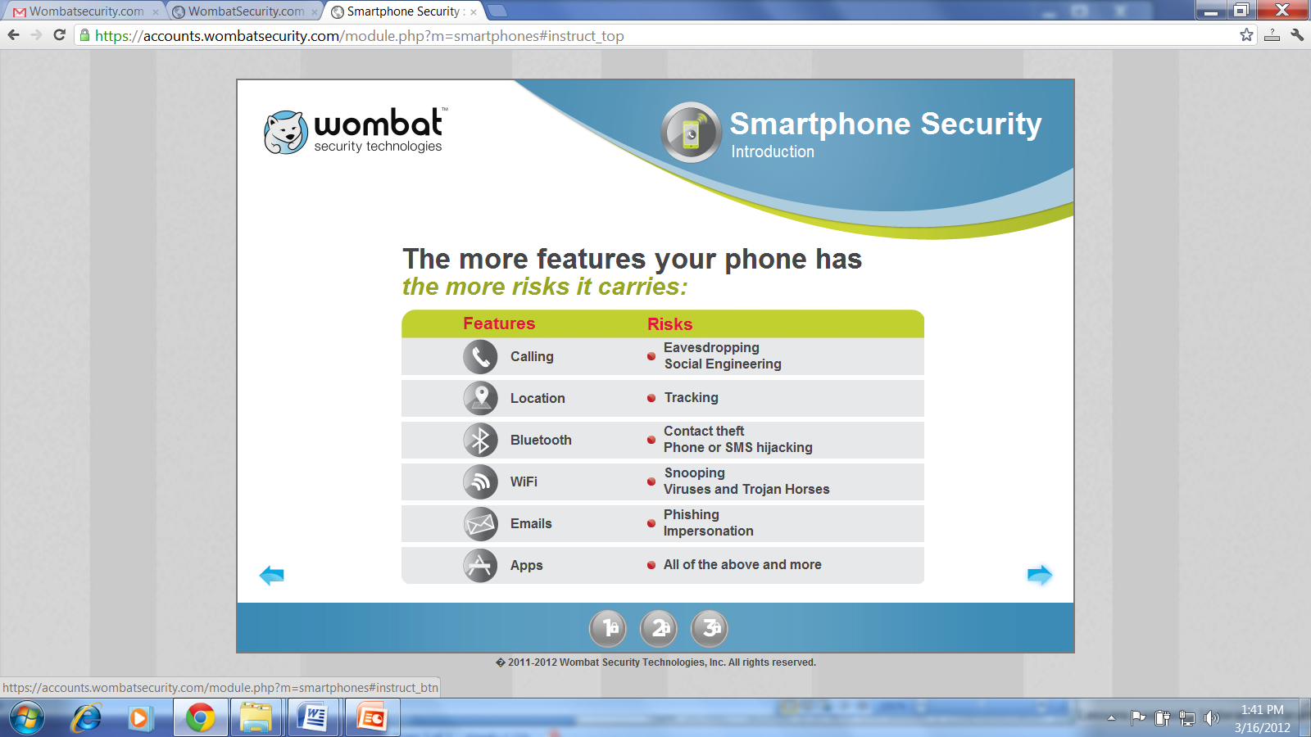
Understanding the Risks: The Big Gap
© Wombat Security Technologies, 2011-2012
© Wombat Security Technologies, 2011-2012
Most people do not realize how sensitive their phones are

Slide 7
Recent Stats (CISCO BYOD March 2013 Study)
9 in 10 US workers use their smartphone for work
40% don’t password protect their smartphones
51% of Americans connect to unsecured wireless networks on their smartphones
52% disable Bluetooth discoverable mode
Source: BYOD Insights 2013: A Cisco Partner Network Study (March 2013) – sample of 1,000 workers. Margin of error: 3%

Slide 8
Physical threats

Slide 9
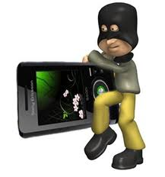
The Biggest Security Risk?
Millions of cell phones lost or stolen each year

Slide 10
Lost or Stolen Phone….
Private data
e.g. contact list, pictures, phone calls, messages, email, calendar, etc
Access to enterprise apps
Risk of someone using your phone
Impersonating you – SMS, voice, email, social networks, etc.
Placing expensive international calls
Reselling your phone
etc.

Slide 11
What Can Users Do?

Slide 12
Preventative Measures
Don’t leave your phone unattended
Write down your IMEI number as well as phone make and model and cell phone number
Use a PIN to protect your cell phone
Different options (e.g. iPhone)

Slide 13
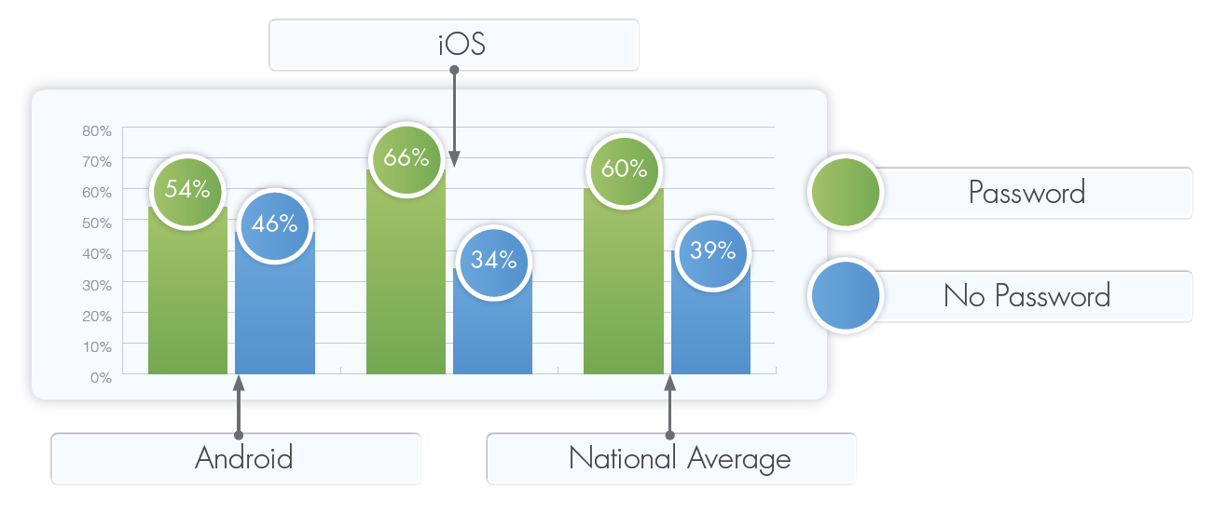
iPhone Users More Likely to have a PIN
Source: BYOD Insights 2013: A Cisco Partner Network Study (March 2013)

Slide 14
What Else?
Remote erase – make sure to regularly “back up”/sync your cell phone…
Track the location of your cell phone – watch out for malware

Slide 15
Sobering Stat (March 2013)
86% of workers say their employers can’t remotely wipe their device’s data
Source: BYOD Insights 2013: A Cisco Partner Network Study (March 2013)

Slide 16
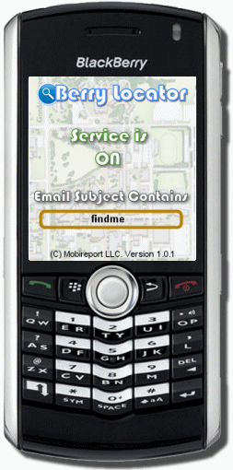
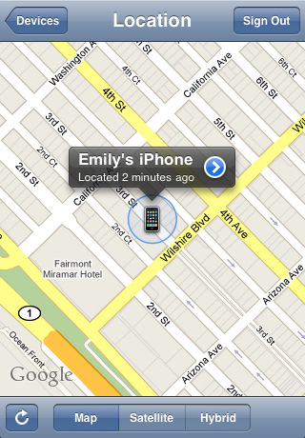
Other Solutions
Loud noise + contact info + map

Slide 17
NETWORK-based Threats

Slide 18

SIM-Based Authentication:Symmetric Cryptography
Mobile
Switching
Center
Home
Location
Register
SIM card
Mobile
Station
Authentication
Center
Mobile
Network
Base
Station
SIM Module
Authentication Center
User
Authentication
Key
User
Authentication
Key
Challenge sent
as randomly generated
number
Randomly
Generated
Number
Randomly
Generated
Number
Authentication
Algorithm (A3)
Authentication
Algorithm (A3)
Mobile Switching Center
Signed Response
Do They Match?
Signed Response

Slide 19
GSM Session Key Generation
SIM
Module
Mobile Network
Mobile
Station
Base
Station
SIM Module
Authentication Center
User
Authentication
Key
User
Authentication
Key
Randomly generated
number
Randomly
Generated
Number
Does this protect you
from rogue base stations?
Randomly
Generated
Number
Session Key Generation
Algorithm (A8)
Session Key Generation
Algorithm (A8)
Session Key
Session Key
Mobile Station
Base Station
Data
Data
Encrypted Session Data
Privacy Encryption
Algorithm (A5)
Privacy Encryption
Algorithm (A5)

Slide 20
Web-based threats

Slide 21

SSL/TLS in Slow Motion
Server
Private key
Server
Public key
Server
Certificate
Server
Certificate
client
server
Generate
Master
Secret
Encrypt with
Server
Public Key
Encrypted
Secret Key
Decrypt with
Server Private
Key
Shared
Master
Secret
Communication with Symmetric Key
and MAC key derived from Shared Secret

Slide 22
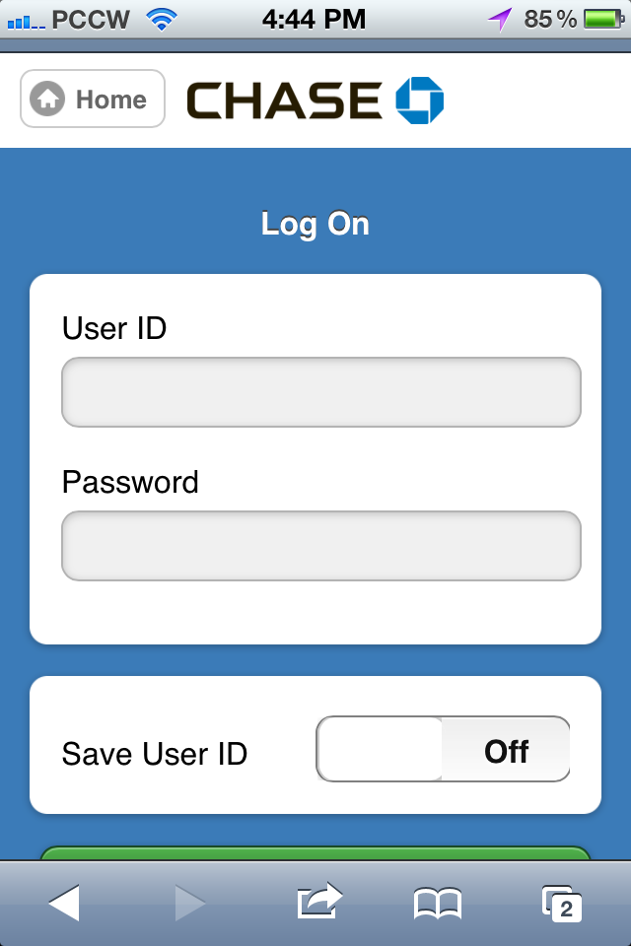
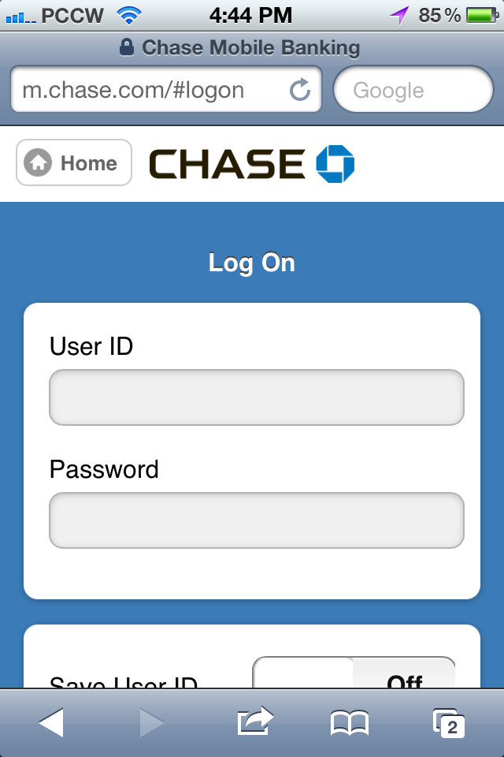
Usability Challenges
Can you tell whether this connection uses TLS/SSL?
You need to scroll up!
(iPhone – iOS5)

Slide 23
E-Mail Phishing: Worse on Mobile Phones
Trusteer – Jan 2011:
Mobile users are first to arrive at phishing websites
Mobile users 3x more likely to submit credentials than desktop users

Slide 24
Beyond e-mail Phishing
SMS-ishing
Vishing
Phishing via social networks
QR phishing

Slide 25
APP-based threats

Slide 26
Android
Applications declare ahead of time the programmatic capabilities they need in an XML Manifest
Manifest could be denied
By user or by cell phone operator
All apps need to be signed by developer
Private certificate held by developer
By default each app has its own ID on a given device and doesn’t share data with other apps

Slide 27
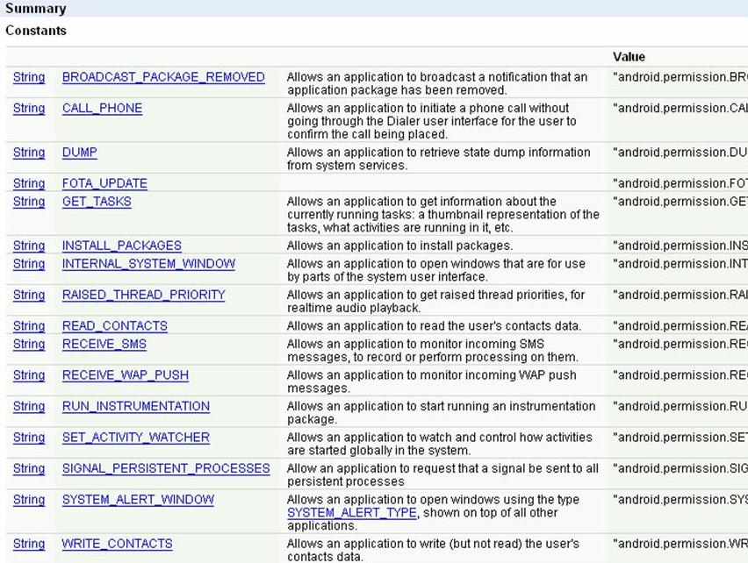
Android Manifest

Slide 28
Malicious Apps
App ecosystems compete based on the number of APIs they expose to developers
Contacts list
Camera
User location
etc.
Technically impossible to fully vet apps
Apple has tried…Google recently started too
Tension between openness, usability, security/privacy, and business considerations

Slide 29
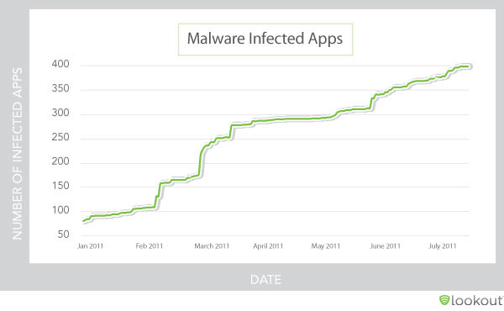
Malware Infected Apps on the Rise
Source:https://www.mylookout.com/mobile-threat-report (June 2011)

Slide 30
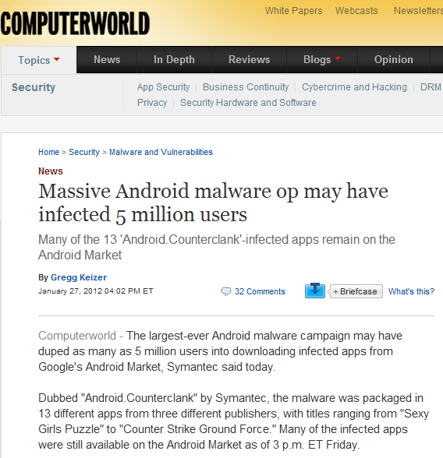
Recent Headlines

Slide 31
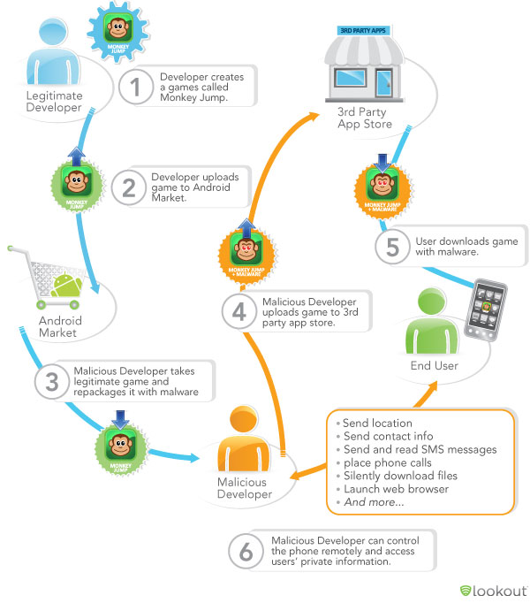
Example of an Infection Scenario
Source:https://www.mylookout.com/mobile-threat-report

Slide 32
Review Process
Apple’s App Store
Apps are reviewed - not perfect
More restrictive sandbox
Android:
Android market/Google Play relies on:
User’s ability to do the evaluation…
…and report security problems
Recently announced “Bouncer Program”
3rd party Android stores (e.g. Amazon): manual review process – but this is not the case on all 3rd party Android stores

Slide 33
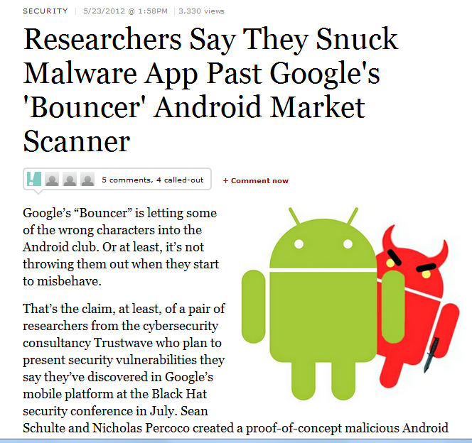
How Good is Google’s Bouncer?
Source: Forbes, May 2012

Slide 34
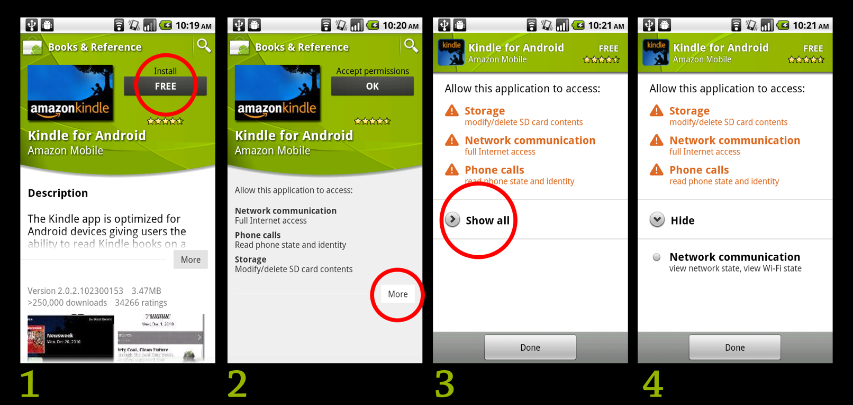
A Study of Android Permissions Screens
P. Gage Kelley, S. Consolvo, L. Cranor, J. Jung, N. Sadeh, D. Wetherall, “A Conundrum of Permissions: Installing Applications on an Android Smartphone”, Proc. Of Workshop on Usable Security (USEC2012), collocated with the 16th International Conference on Financial Cryptography and Data Security, March 2012
Notes:
Current process for installing an application.

Slide 35
Interview Findings
Users do not understand Android permissions.
The terms are at best vague, and at worst confusing, misleading, jargon-filled, and poorly grouped
This lack of understanding makes it difficult for people to make informed decisions when installing new software on their phones
Largely, the permissions are ignored, with participants instead trusting word of mouth, ratings, and Android market reviews.
While participants stated they try to find good applications in the market, they believe they are protected by oversight processes which do not exist.
Overall, users are not currently well prepared to make informed privacy and security decisions around installing applications from the Android market.

Slide 36
Android Today: Around 130 Permissions
Too coarse in some cases
Too fine or superfluous in other cases
Abuse – unnecessary permissions
Ill understood by users
Hundreds of malicious apps
Google Play is doing better but there are tens and tens of other Android stores….

Slide 37
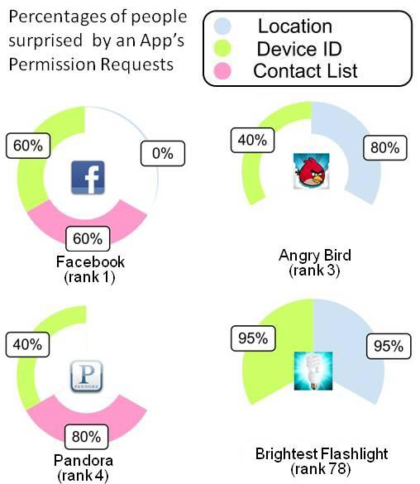
Most People Have No Idea
J. Lin, S. Amini, J. Hong, N. Sadeh, J. Lindqvist, J. Zhang, “Expectation and Purpose: Understanding Users’ Mental Models of Mobile App Privacy through Crowdsourcing”, Proc. of the 14th ACM International Conference on Ubiquitous Computing, Pittsburgh, USA, Sept. 2012

Slide 38
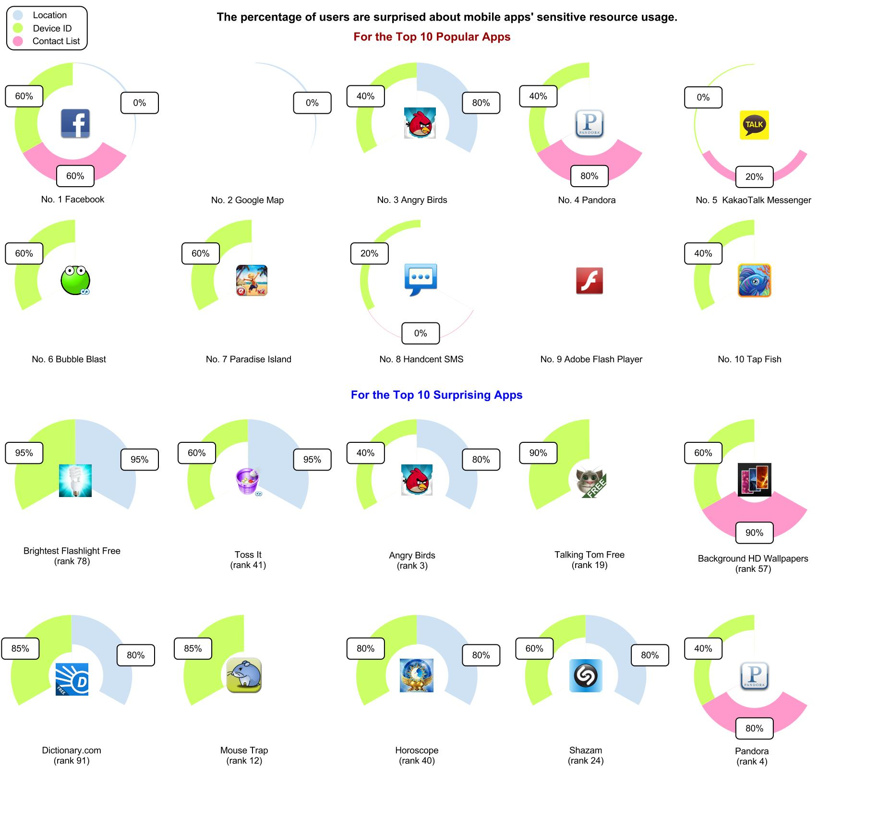
More…

Slide 39
Some Recommendations
Research apps before you download them
Best to wait until enough other people have tried them
Check ratings – but do not rely entirely on them
If you are courageous, take time to review privacy provisions
Possibly create a Google alert for apps you download

Slide 40
BYOD & Mobile Security: An Enterprise Perspective

Slide 41
Reconciling BYOD and Security
People need the devices to be productive
Policies that are unrealistic will just encourage employees to circumvent them
Complex tradeoffs
No silver bullet

Slide 42
Very Specific Regulations (US Examples)
Financial Services
SEC Rule 17a-4, NASD 3010: retain and protect integrity of communications
FINRA 11-39 includes provisions for the use of personal devices – requirements apply independently of whether the device is company-owned or employee-owned
Health Care
HIPAA and HITECH – “Protected Health Information” (“PHI”)
Protect private data, including BYOD devices
All corporate email, data and documents has to be encrypted – both in transit and at rest on all devices
Remotely configure and manage device policies
Monitor device integrity
Protection against malware and cyber threats
Up to $1.5M penalty per data breach

Slide 43
What Can We Do?
Malware protection
Mobile Device Management – over the air
Remote wipe, strong passwords, time-outs
Limit BYOD to supported versions of OSs, storage encryption, nb. of failed logins, etc.
May require a transition period
Separate containers for sensitive corporate apps and data
Possibly limit remote wipe to corporate container
Enlist help of phone carriers – e.g. SMS filtering
Educate Users
Continue to follow developments

Slide 44
Mobile Device Management
Support over-the-air configuration and management of mobile devices
Settings, apps, data – a lot more than email & calendar
Monitoring
Allows companies to enforce consistent policies in a BYOD context
Multiple devices, multiple OSs, multiple operators
Both company-owned and employee-owned (BYOD)
Complex tradeoffs between productivity/empowering employees & security
Needs to be supplemented with employee training

Slide 45
MDM Architecture
Server or cloud (SaaS) component: sends management commands to mobile devices
Apps, settings, data, commands
Client component running on the mobile device
Responsible for executing commands received and for reporting
Commands sometimes sent as binary SMS messages

Slide 46
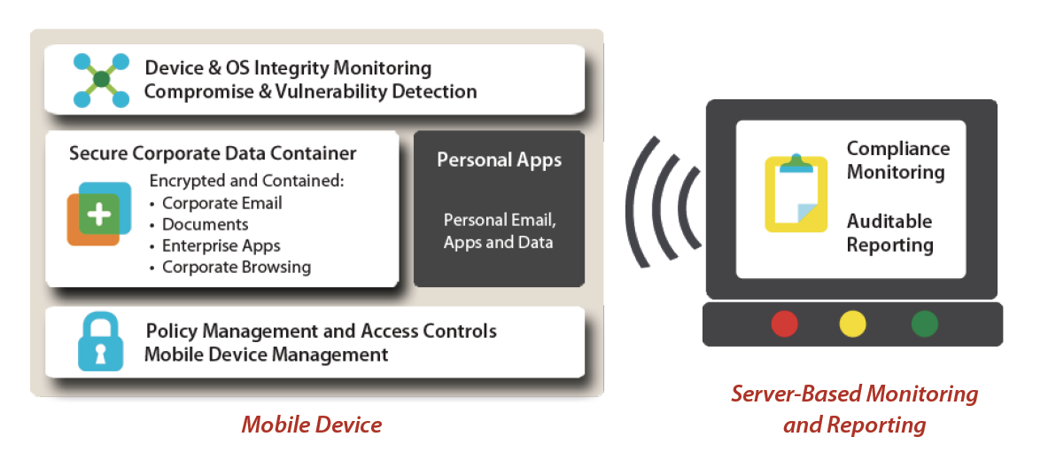
Fixmo: Example of a Product
AES 256 bit encryption
Source: Fixmo

Slide 47
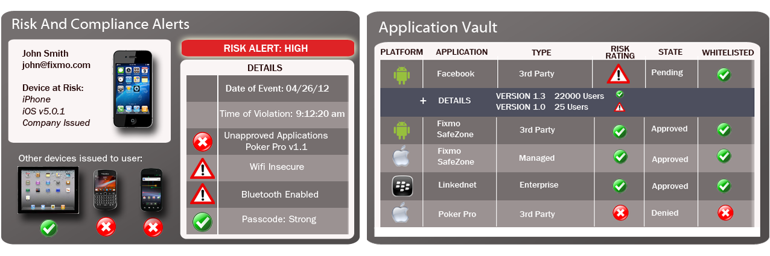
Fixmo Sentinel Integrity Services
Device Integrity Verification & Detection
Automated Response and Exploit Prevention
Forensic Audit Reporting
Source: Fixmo

Slide 48
Fixmo Sentinel MDM
Centrally configures and manages Android, iOS and Blackberry devices
Centralized user and group management – active directory
IT Policy management and security setting configuration
Wireless commands to lock, reset and wipe mobile devices
Device, carrier and location information reporting (GPS location)
Compliance and audit reporting

Slide 49
FixMo SafeZone
Creates secure workspace/container on the smartphone that is encrypted and managed by IT
Corporate email
Corporate documents
Corporate browsing (e.g. intranet, extranet)
Corporate apps (e.g. email, calendar, ERP access)
Secure camera
Can’t move data from consumer side to corporate container or vice versa
Can be wiped remotely
Video: http://www.youtube.com/watch?feature=player_embedded&v=oGXdlOi-B7s

Slide 50
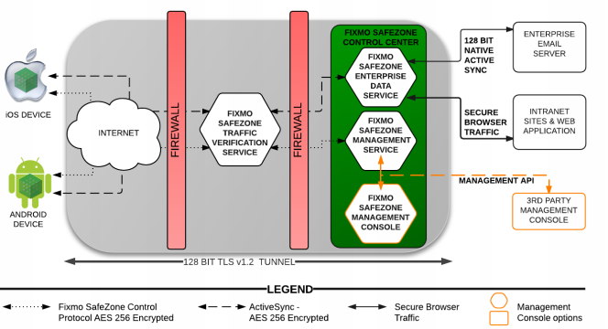
FixMo SafeZone

Slide 51
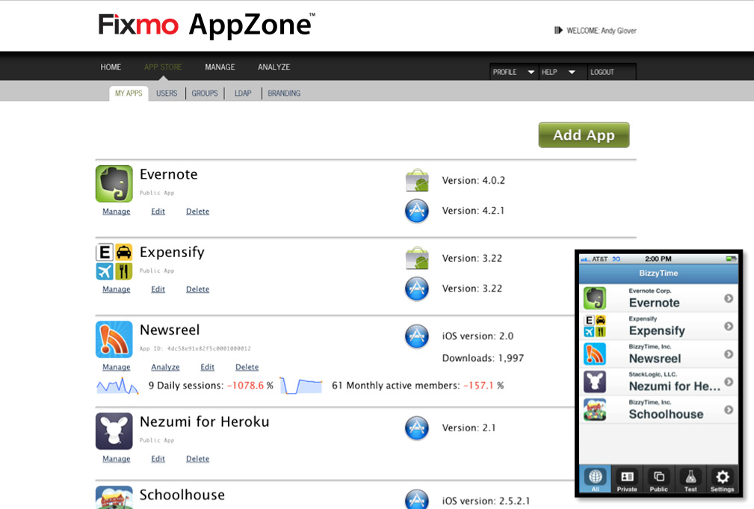
Fixmo AppZone

Slide 52
Understanding the Limitations of MDM
Blurring between private and work life
Many non-corporate apps and functionality can be sources of vulnerability
Posts on facebook
Location via foursquare
Pictures that are geo-tagged
Apps that leak sensitive information
Colleagues that you have sent Gmail emails to
And more…

Slide 53
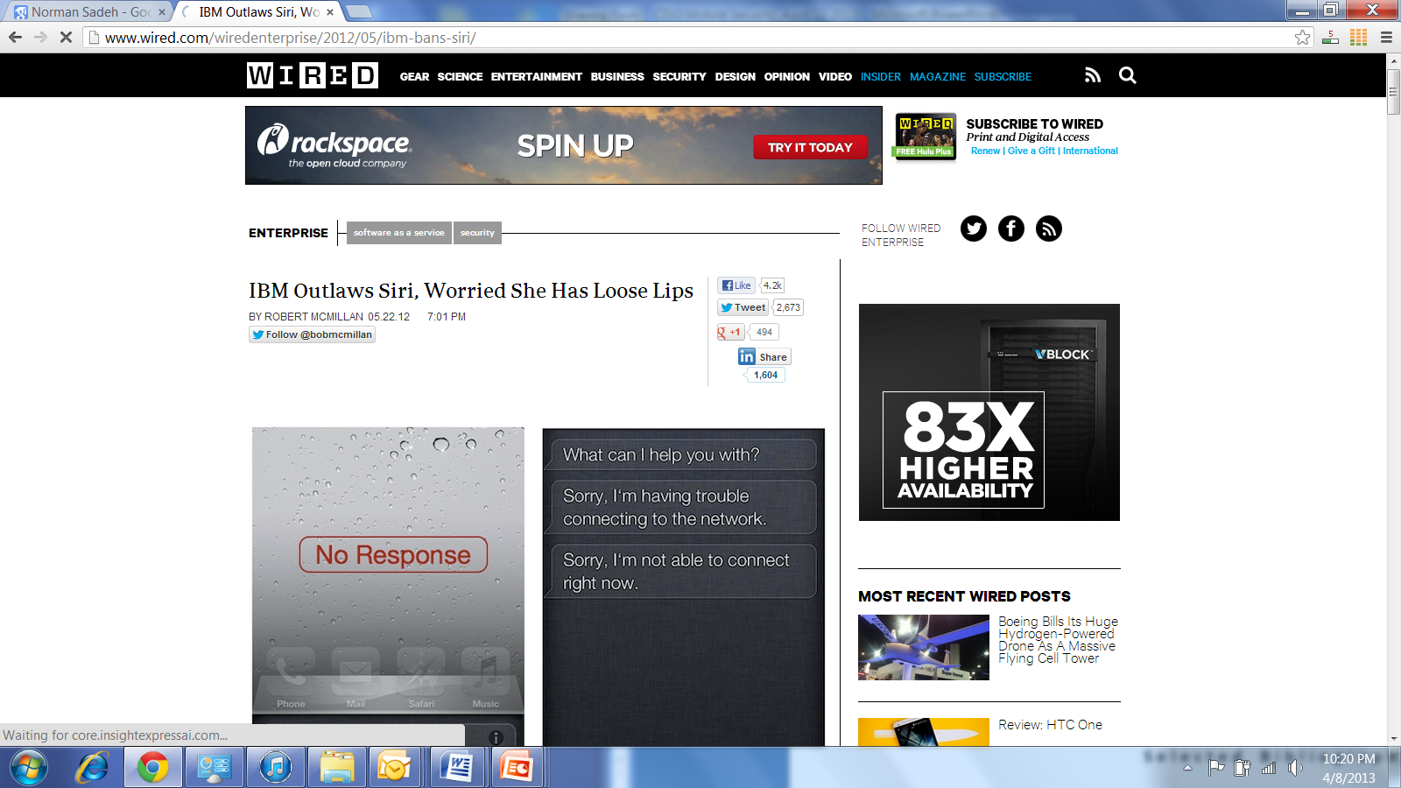
Follow Developments
Apple's iPhone Software License Agreement: "When you use Siri or Dictation, the things you say will be recorded and sent to Apple in order to convert what you say into text,… By using Siri or Dictation, you agree and consent to Apple's and its subsidiaries' and agents' transmission, collection, maintenance, processing, and use of this information, including your voice input and User Data, to provide and improve Siri, Dictation, and other Apple products and services."

Slide 54
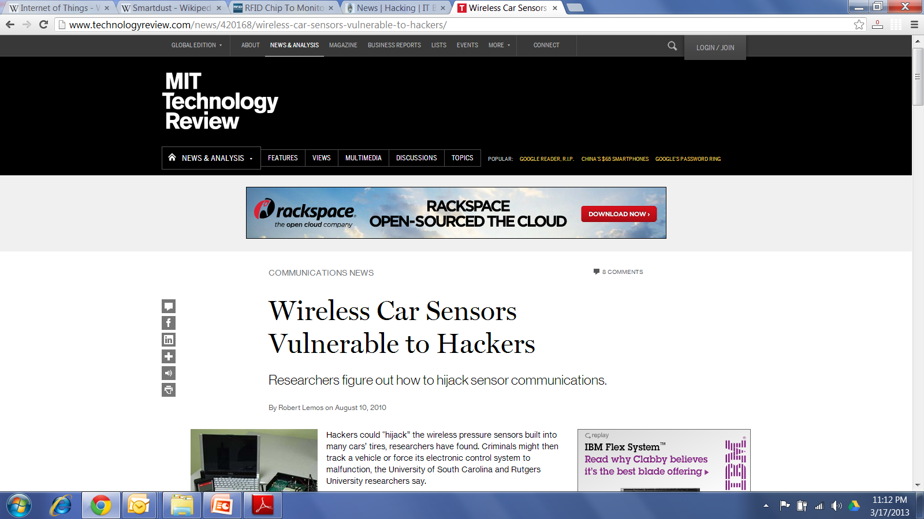
Mobile is Just the Beginning: Think about Pervasive Computing & the Internet of Things
Wireless tire pressure in each tire mandated by TREAD Act in US
Tracking cars – each sensor has a unique ID!
Hacking into a car’s Electronic Control Unit wirelessly
From honking to flashing lights…to crashing the ECU

Slide 55
Mobile Security : Overall Summary
Mobile security requires special attention:
Access to rich set of sensitive apps/services/data – highly personal devices
Wide range of usage scenarios & vulnerabilities
Diverse environments
Poor user understanding of vulnerabilities
Attractive targets given the number of users
Key players are slowly loosening their grip over the value chain but there are tradeoffs
Business
Security
Usability

Slide 56
References
Required: These slides
Optional:
Mobile and BYOD, Info World Special Report, December 2011 (available on blackboard)
“IBM worries iPhone’s Siri has loose lips” (May 2012) http://www.cnn.com/2012/05/23/tech/mobile/ibm-siri-ban/index.html
Cloudmark – Mobile Security Solutions Guide, June 2012 (available on blackboard)

Slide 57
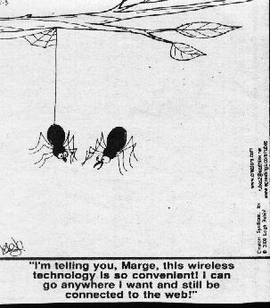
Q&A
Source:
http://www.rudezone.com/cartoon4/wireless.html

Slide 58
Additional Slides for Background
Mobile Security: Everyday User Training

Slide 59

Training has a Big Role to Play
…But training has traditionally failed
Security is a secondary task: employees are not motivated to learn
Traditional delivery methods and content have not been very compelling
Required knowledge is vast & continues to grow
Practical strategies and tips are not always easy to articulate

Slide 60
Priming Users for Training
Challenge them to take quizzes
…or better: Motivate them via mock attacks
Nothing beats showing a user how vulnerable (s)he is

Slide 61
Phishing as An Example
Email phishing: Much worse on mobile phones
Mobile users are first to arrive at phishing websites
Mobile users 3x more likely to submit credentials than desktop users
Source: Trusteer, Jan. 2011 – similar

Slide 62
Training via Mock Attacks: PhishGuru
Teach people in the context they would be attacked
If a person falls for simulated phish, then pop up an intervention
Unique “teachable moment”

Slide 63
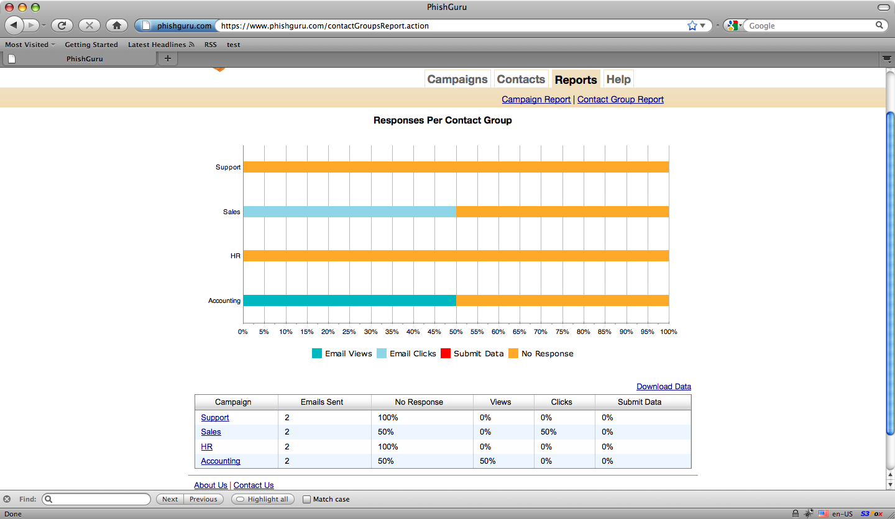
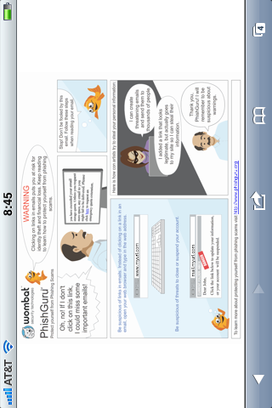
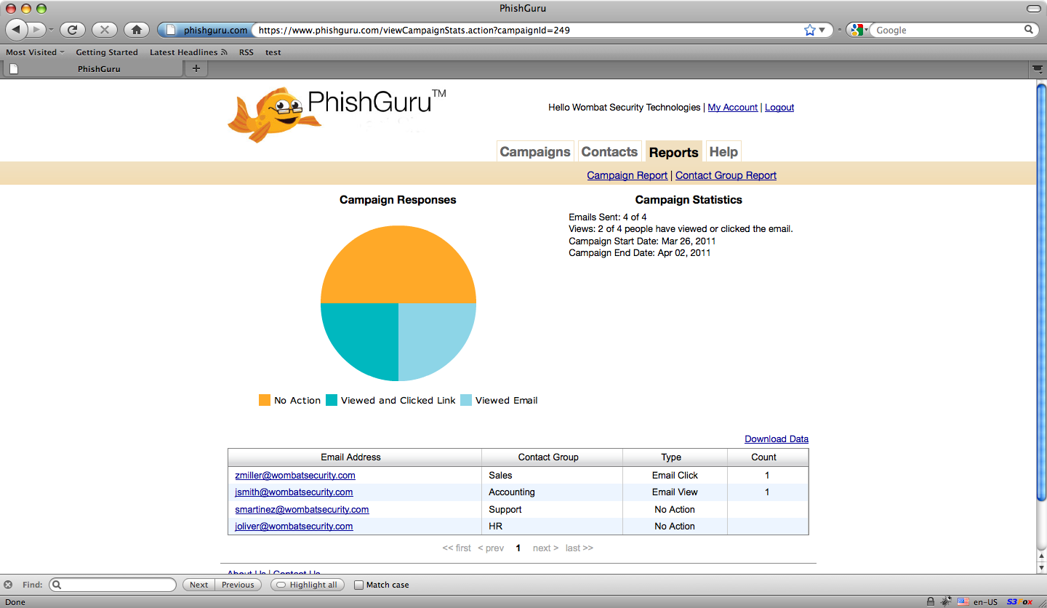
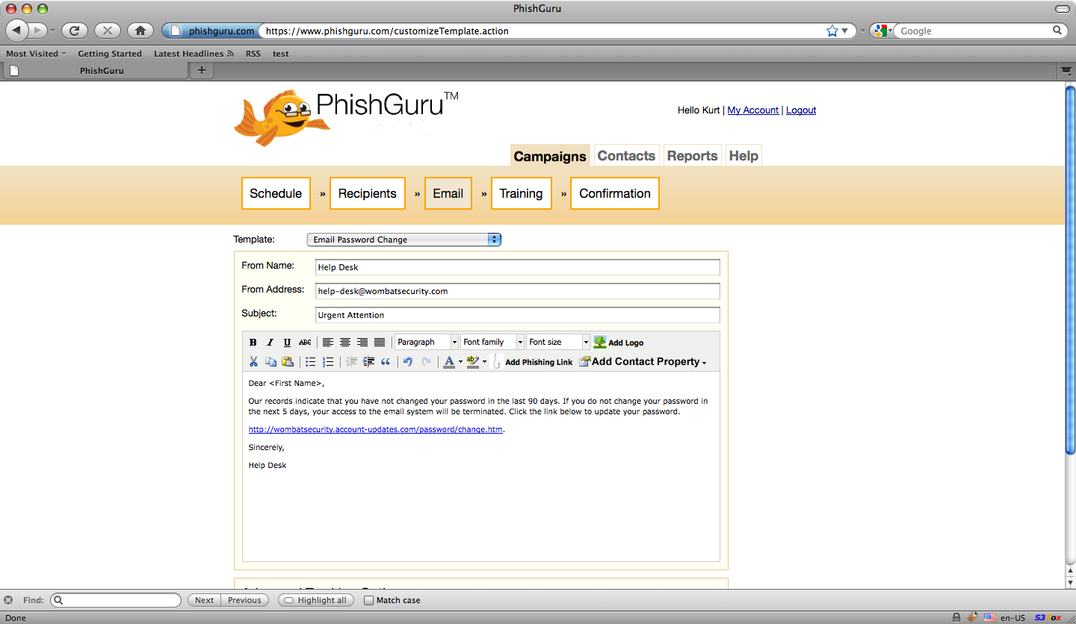
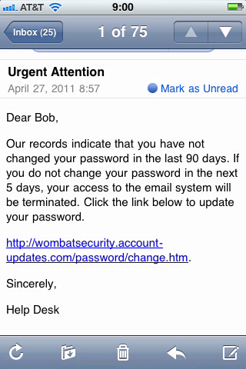
Select
Target
Employees
Customize
Fake
Phishing
Email
Select
Training
Internal
Test and
Approval
Process
Hit
Send
Monitor
& Analyze
Employee
Response

Slide 64
This really works!
Reduces the chance of falling for an attack by more than 70% !
percentage
Actual Results

Slide 65
Starting with the Most Common Threats
Teach people the importance of having a PIN number
Teach people the importance of not leaving their phone unattended

Slide 66
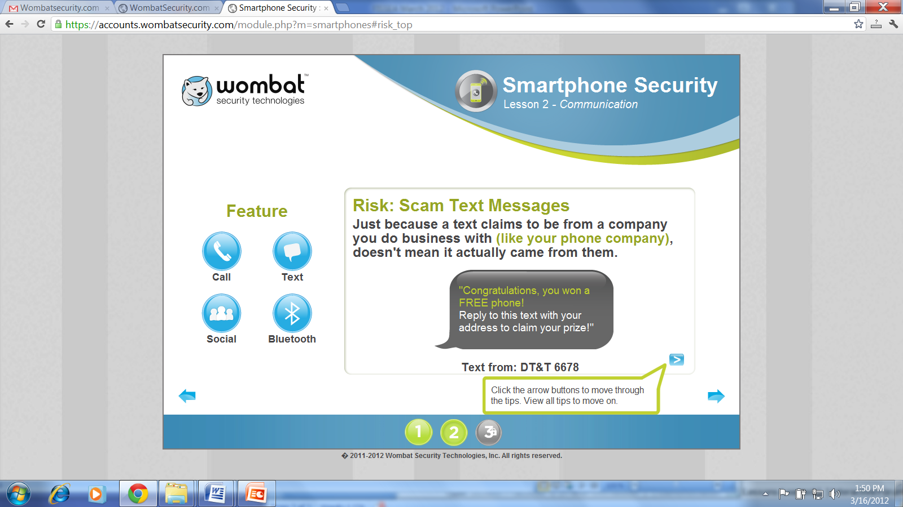
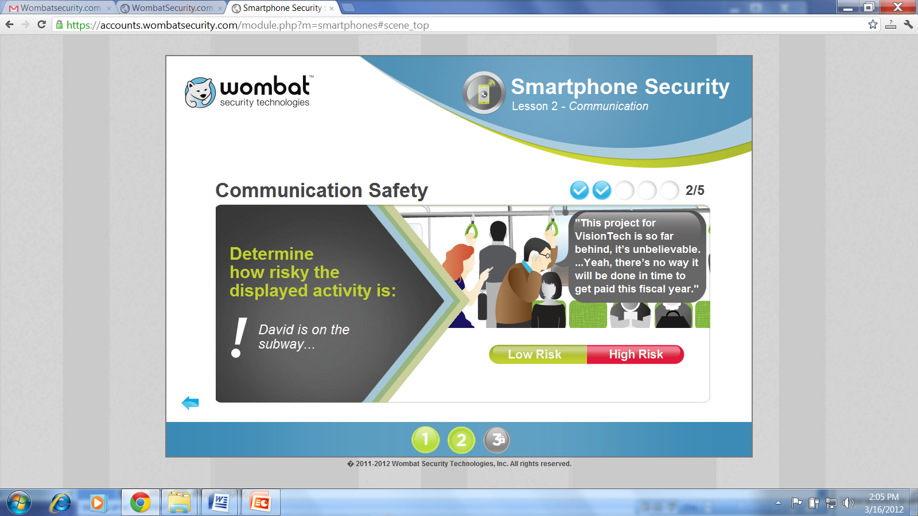
Learning by Doing is Critical
© Wombat Security Technologies, 2011-2012
Teach people to better appreciate the risks
Create mock situations
Force them to make decisions
Provide them with feedback

Slide 67
Gradually Move Towards More Complex Tasks
Mobile Apps
Location
Social Networking

Slide 68
Mobile Apps
Challenge: difficult to come up with full-proof rules
Train people to be suspicious & look for possible red flags
Emphasis on:
Learning by doing
Feedback
Opportunities for reflection

Slide 69
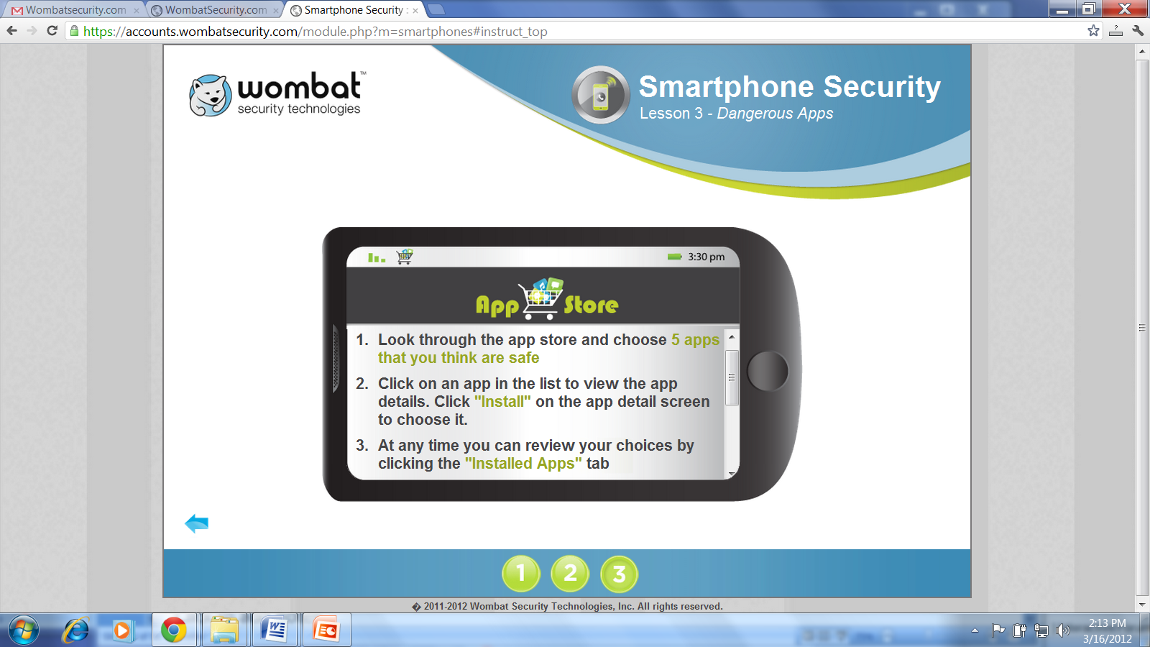
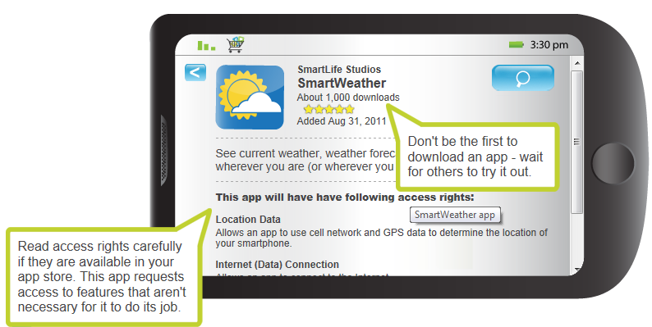
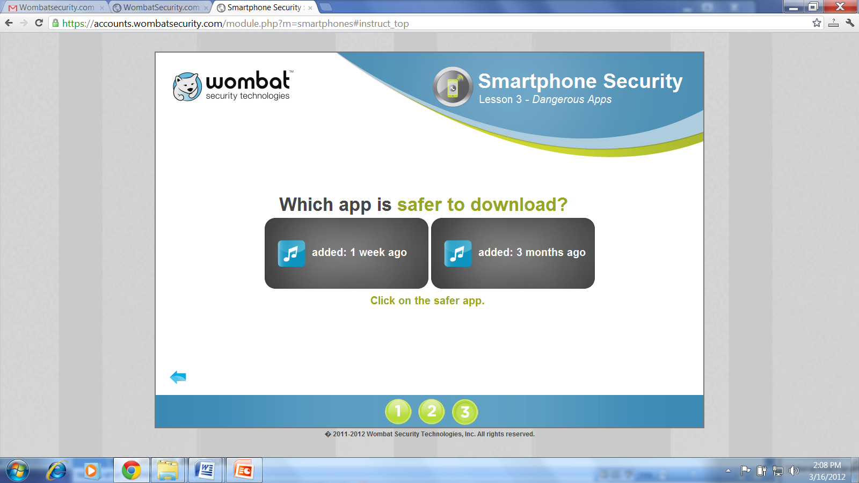
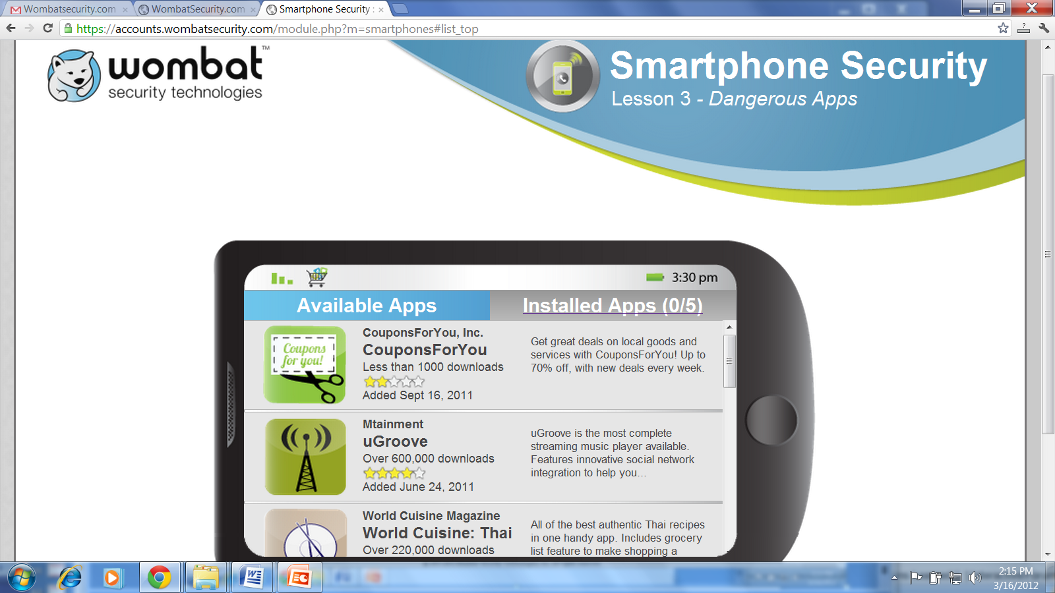
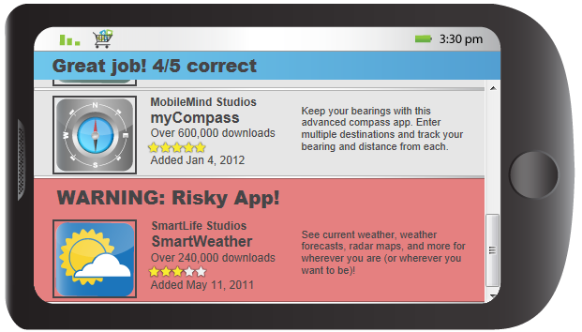

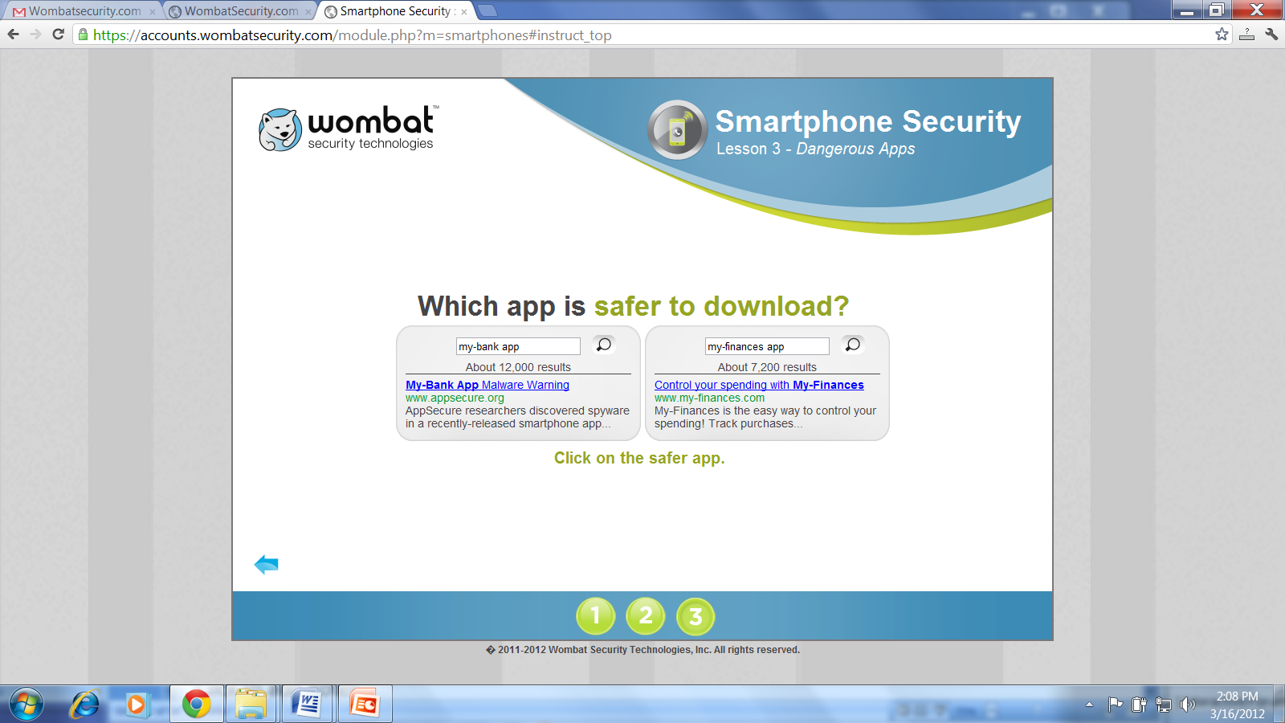
From Simple to Increasingly Realistic
Courtesy: Wombat Security Technologies

Slide 70
Additional Slides for Background
Mining User Mobile App Reviews to Detect Security Problems

Slide 71

The WisCom Project
13 million mobile app reviews
171,000 Android Apps
“Why People Hate Your App: Making Sense of User Feedback in a Mobile App Store”, Bin Fu, Jialiu Lin, Lei Li, Jason I. Hong, Christos Faloutsos, Norman Sadeh – to appear KDD 2013

Slide 72
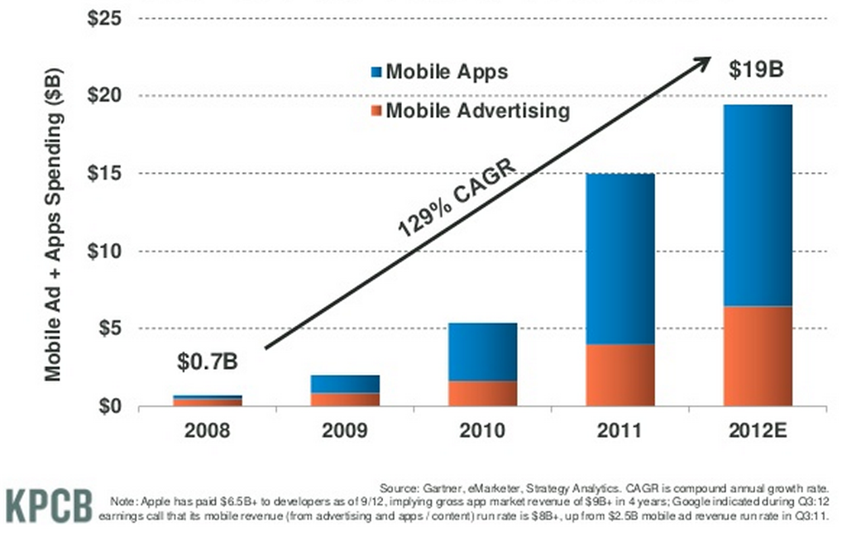
Gobal Mobile App & Mobile Ad Markets

Slide 73
Life Before the App Store
Mobile Apps have been around for a dozen years…
…but, prior to the App store, few people:
Knew how to find and download apps
Were willing to give their credit card details to companies they had never heard of
…at best 2 guys in a garage…at worst a scheme to get your credit card credentials
The App Store is about addressing fundamental trust and usability issues

Slide 74
Lots of Bad Apps
From malware
To apps that….
Will crash your phone
Abuse your privacy
Drain your battery
Waste your money
Waste your time
…and more…
Could App stores leverage user comments to automatically take down bad apps and help developers fix their apps?
“Why People Hate Your App: Making Sense of User Feedback in a Mobile App Store”, Bin Fu, Jialiu Lin, Lei Li, Jason I. Hong, Christos Faloutsos, Norman Sadeh – to appear KDD 2013

Slide 75
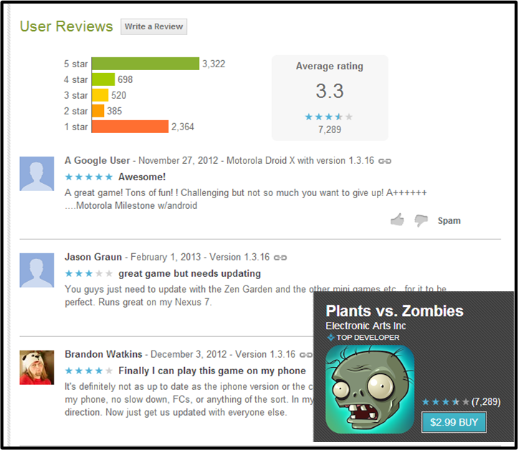
Distinct Features of App Reviews (in contrast to other product reviews)
Shorter in length
More typos, slang, ill-structured sentences
Reviews of the same app can refer to different versions

Slide 76
Motivations for Analyzing User Reviews
App store: Manual inspection of hundreds of thousands of apps is impractical. Maintaining user trust & prevent manipulation
End-user: Develop summary of what others think about an app
App developer: Help identify & diagnose problems associated with user complaints
Analyze overall market & spot trends
What are those issues that matter most to users in different app categories

Slide 77
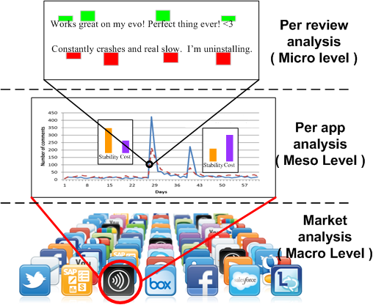
WisCom: A Multi-level Review Summarization System
Per Review Analysis: Sentiment analysis on each review, identify inconsistent reviews
Per App Analysis: Topic modeling on aggregated reviews, detect major releases and identify major sources of complaints
Market Analysis: analyze market segments & spot trends, incl. user preferences. Can also help develop/refine app development guidelines

Slide 78
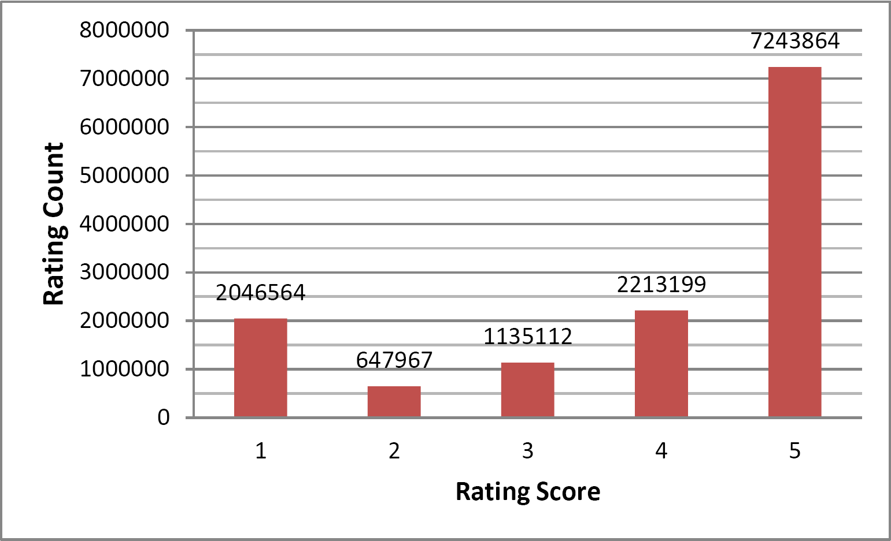
Dataset: 13 million Android App Reviews
Meta-information of 171,493 Android app in Nov 2012.
136,086 free apps
A total of 13,286,706 user reviews
2.7M negative, 9.5M positive
~ 32.4GB storage
-Crawled Google Play – Looked at 171,000 Android apps(Nov. 2012)
- Info about the identity of the reviewer is not available

Slide 79
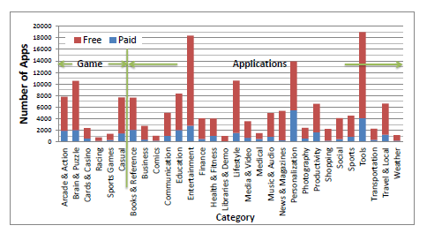
Apps by Categories

Slide 80
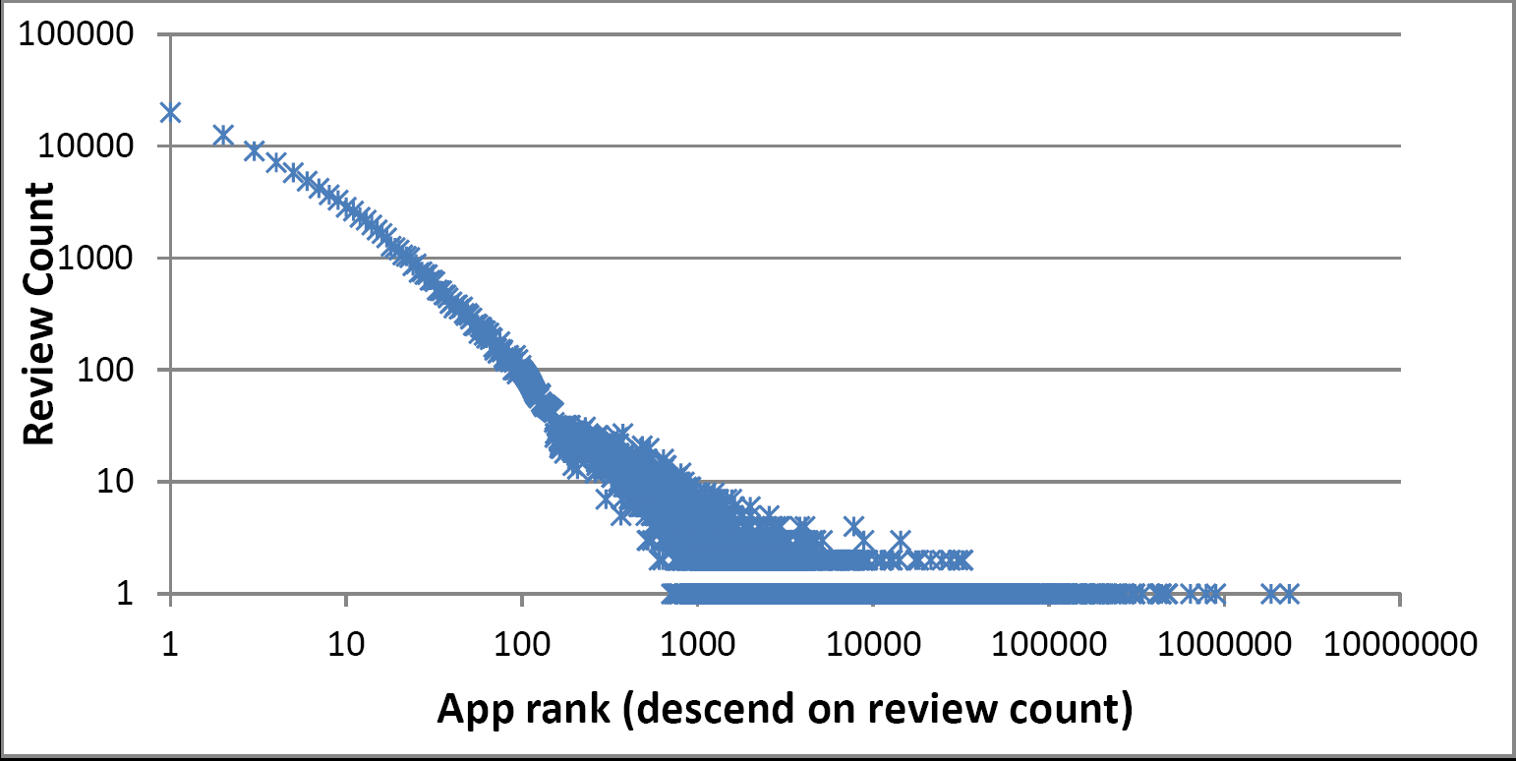
Dataset
The number of comments follows a heavy tailed distribution.
Average number of comments = 101.90, STD = 460.25, median=8

Slide 81
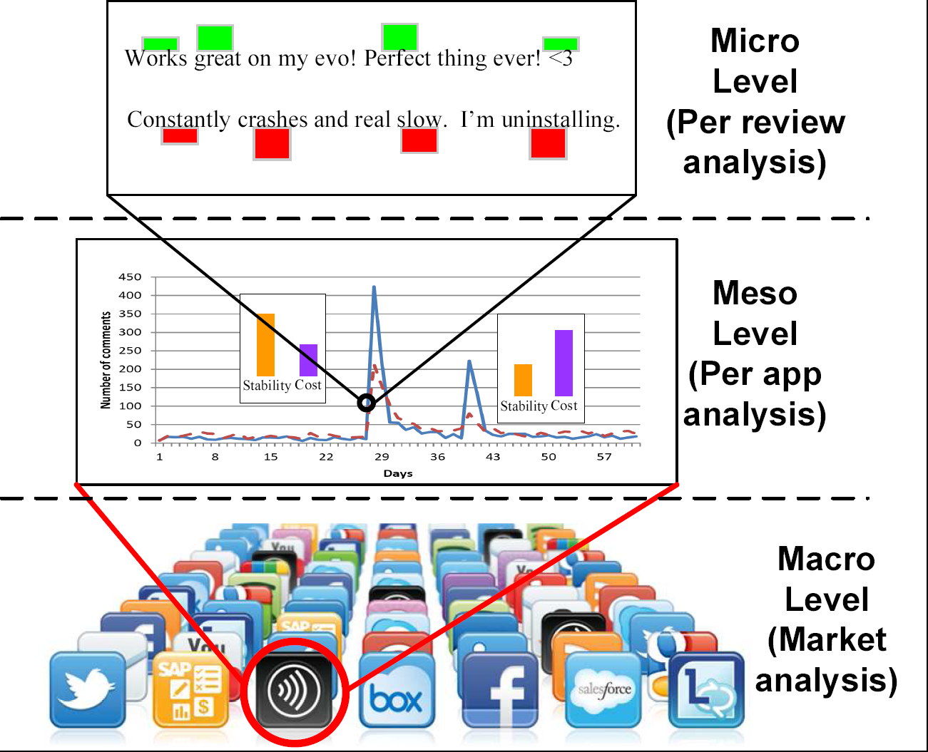
per Review Analysis
Used 3 as threshold between “positive review” and “negative review”
-Avg rating is 3.9 and 54% of apps are rated 5 stars.
Notes:
Sentiment analysis, extract the vocabulary that can be used for further analysis

Slide 82
Preprocessing
Sample 8% of the comments (1 million reviews)
Remove HTML tags and delete non-English reviews
Segment comments into words
Remove rarely used words.
Yield 19K distinct words, from 988K comments.

Slide 83
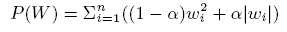
Linear Regression Model
Where m=988K, n=19K, Y: reported ratings
Xij is frequency of j-th word in i-th comment
Wj is the weight of j-th word in vocabulary
Normal Tikhonov regularization to reduce overfitting,
L1 norm, penalty of complexity of model – forces a number of zero weights for words that don’t matter
Notes:
Objective function of the regression model

Slide 84
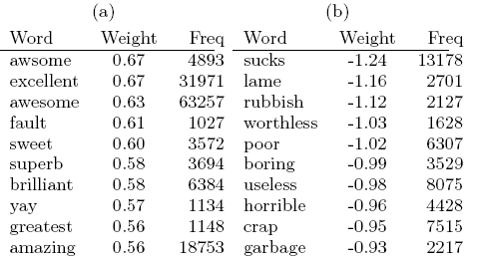
Most Positive and Negative Words
Notes:
However, most of the words only express strong feeling, but not telling us the reasons. Let’s see another set of words that we picked up from the model

Slide 85
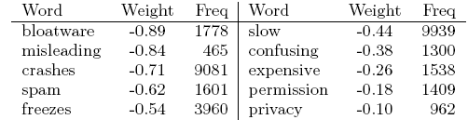
Examples of Negative Words that Imply Problems
Some negative words are particularly informative and hint to the
source of a user’s complaint
Notes:
This is also motivate us to proceed to the next level, to find the root cause of bad reviews

Slide 86
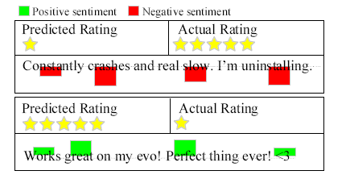
Detect Inconsistent Reviews
0.9% of the reviews are inconsistent with their ratings.
Might be attributed to carelessness or could be sign of intentional manipulation
Inconsistent reviews were removed for later analysis

Slide 87
Per app analysis
Can we monitor apps and, based on reviews, identify and help diagnose problems associated with complaints?

Slide 88
Topic Analysis
Preprocessing:
Only on negative reviews, and negative words → avg. 71 characters, median length is 47 characters.
Removed inconsistent comments
Only negative comments associated with 1-star and 2-star ratings
Removed words with non-negative weights
Concatenate comments from the same app as documents (otherwise too short)
Remove apps with too few comments: This left us with >52K apps to analyze
Latent Dirichlet Allocation model (LDA)
Identify 10 topics

Slide 89
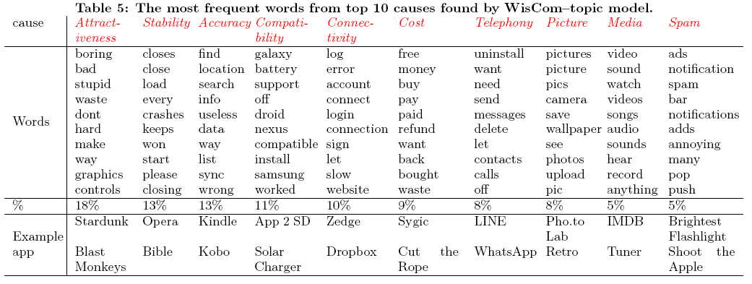
Top 10 Root Causes
Notes:
Some contain features, like , picture, media, telephone, some relate to performance such as stability, compatibility, etc.
Others talking about cost.
These 10 topics are the most significant ones that detected cross the whole market

Slide 90
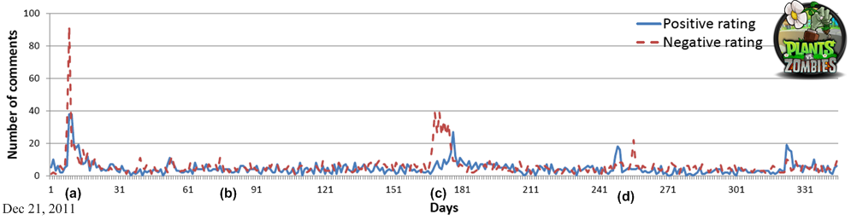
Dynamic View: Life Story of App (I)
Notes:
Here we use Plants and Zombies as an example to illustrate how root causes analysis + time series visulization can help us understand how an app evolves over time.

Slide 91

Dynamic View: Life Story of an App (II)

Slide 92


Understanding the Problem

Slide 93

The Life Story of an App

Slide 94

Dynamic View: Life Story of App

Slide 95
Market-Level Analysis
Do users care about the same issues and/or exhibit the same level of tolerance for different app categories?
Possible guidelines for developers

Slide 96

Outstanding Complaints in Each Category

Slide 97

Users’ Reception of Free and Paid Apps
100 free/paid apps/games with the most reviews:
For paid apps: cost dominates
For paid games: other factors matter too
Notes:
100 most reviewed free applications and 100 most reviewed free games, paid and paid
Application received more unified complains. Left…. , game can attribute to multiple reasons
Horizontally, 1 higher quality in general
Users more tolerant to cost of games than applications

Slide 98
Summary
WisCom provides analysis at 3 different levels
WisCom can
Detect inconsistent reviews,
Identify root causes of complaints
Provide historical view of apps
Help identify market trends and develop guidelines

